Slide 1


BOOK ONLINE
HUST
SHOPPING
Presentation By Group 4:
Nguyễn Tiến Tuân-20184321
Đỗ Xuân Dũng -20184243
Trần Ngọc Đức -20184245
Mentor: Mr.Dao Thanh Chung
1

Slide 2

Table Of Content
Introduction
Demo
Project Structure
Extension
Features
Contributor
Group 4
2

Slide 3

Introduction
Why do we need book ecommerce website ?
-
_ Customer Convenience: simple and easy option for customer to make purchases.
-Unlimited capacity: having an online database allows you to offer a wider range of titles and increase their exposure to all the stock you have.
-Enhanced customer experience: gives readers the ability to check reviews, comments, suggestions, and feedback
-
Group 4
3

Slide 4

Introduction
Technology used:
-HTML,CSS,JS
-JQuery
-Bootstrap
-PHP 8.0.1
Group 4
1

Slide 5
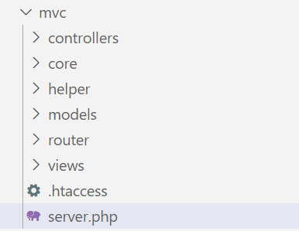
Project structure
-controllers: defines user interface reacts to user output.
-core: config database ,constant.,...
-helper: help funtion.
-models: manage the data.
-router: define route.
-views: display the data.
Group B
4

Slide 6
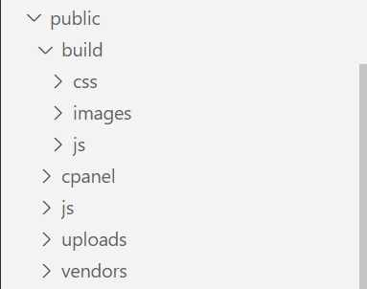
Project Structure
-css: contains css files
-images: contains image files
-js: contains js files
-uploads: contains imagesafter upload sucess.
-vendors: contains libraries.
Group B
4

Slide 7
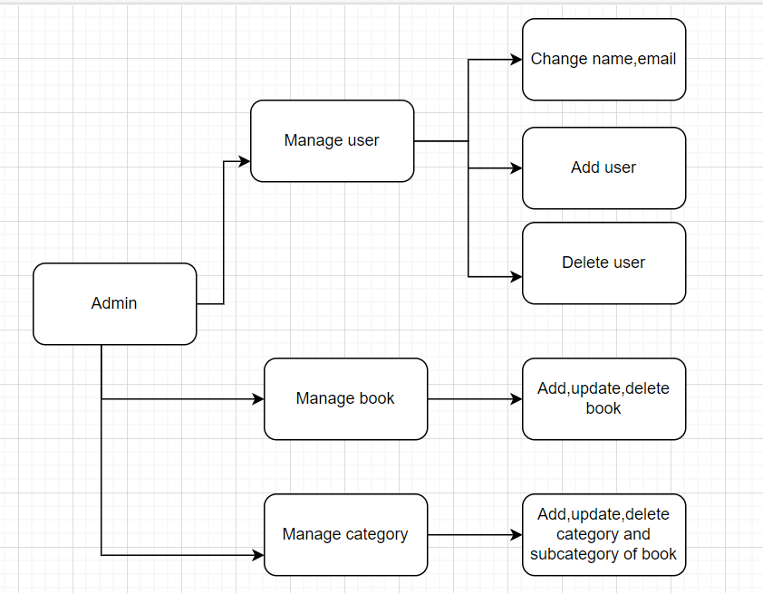
Features
Group 4
4

Slide 8
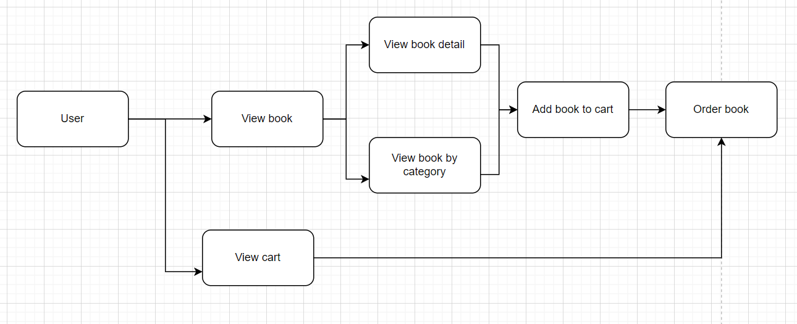
Features
Group 4
4

Slide 9



Contributor
Nguyễn Tiến Tuân
Đỗ Xuân Dũng
Trần Ngọc Đức
-Handle manage products,users, categories,carts.
-Handle admin view.
-Design database
-Handle login ,signup
,logout for admin and user.
-Design database
-Handle user view (product,category, cart).
-Design database.
Group B
8

Slide 10
Extension
1
Payment method
Intergrated some payment method like Momo,ZaloPay, Paypal,...
2
Search product
User can find the product to view and buy it easily.
3
Authentication by google,facebook
User can register and log in by google or facebook and quickly reach the website.
Group B
5

Slide 11

If you have any questions about e-commerce, welcome to ask
Thank you for your attention

